Slide 1


Cyber Security Assessment Tool

Slide 2
Introduction
Organizations have to know their cyber security vulnerabilities
Market demands to take security seriously
Law regulations and market standards (GDPR/ISO27k)
Organizations need an action plan to improve cyber security
Notes:
We believe that every organization wants to improve security! We also believe that many organizations struggle with security budgets and that alignment between IT/Security and Business Management is not optimal.
'We want to help organizations to create an action plan to improve security.'

Slide 3




ATP
Notes:
An example of a typical IT environment. On the left-hand side the on-premises servers and Active Directory. There are cloud applications in use, some with company’s approval, others are ‘Shadow IT’. And of course laptops and PC that people work with. A complex environment that is growing in complexity when your company is growing.

Slide 4
‘Cyber Activity’
Customers
Partners
Contractors
ATP
Administrators
Employees
Notes:
But it becomes even more complex when we have a look at the cyber activities. These are the interactions that take place in the IT environment. Administrators working on support and development in the environment, Employees collaborating and inviting external partners and customers to access information. And documents and data flying around between all stakeholders.

Slide 5
Recommendations based on FACTS
120 Cloud Applications being used and no policy in place.
Azure AD B2B/B2C
Customers
Partners
Contractors
230 external users with access to SharePoint sites
Cloud App Security
All OS versions and service packs up to date.
All endpoint policies in place.
ATP
24,000 Documents with potential PII located in Office 365 and Fileshares.
Azure Information Protection
Privileged Identity and Access Mgmt
Administrators
60 users with admin accounts
Employees
Notes:
We, at QS solutions, believe that improving security can be done efficiently, by providing recommendations based on facts from the IT environment. What we deliver is an action plan on how to improve the organization’s security by doing recommendations based on the facts in the company's IT environment. Here are some examples on what our Cyber Security Assessment Tool could find…
All endpoint policies in place, perfect no action needed in this area.
60 users with administrator rights, no problem if your organization employs over 10.000 people, but a mayor issue if this is only 100.
230 external users with access to SharePoint sites. Who are these people, who is responsible for providing access, and maybe even more important, who is responsible for revoking access?
With the CSAT you will be able to provide recommendations based on actual facts form your customers IT environment.

Slide 6
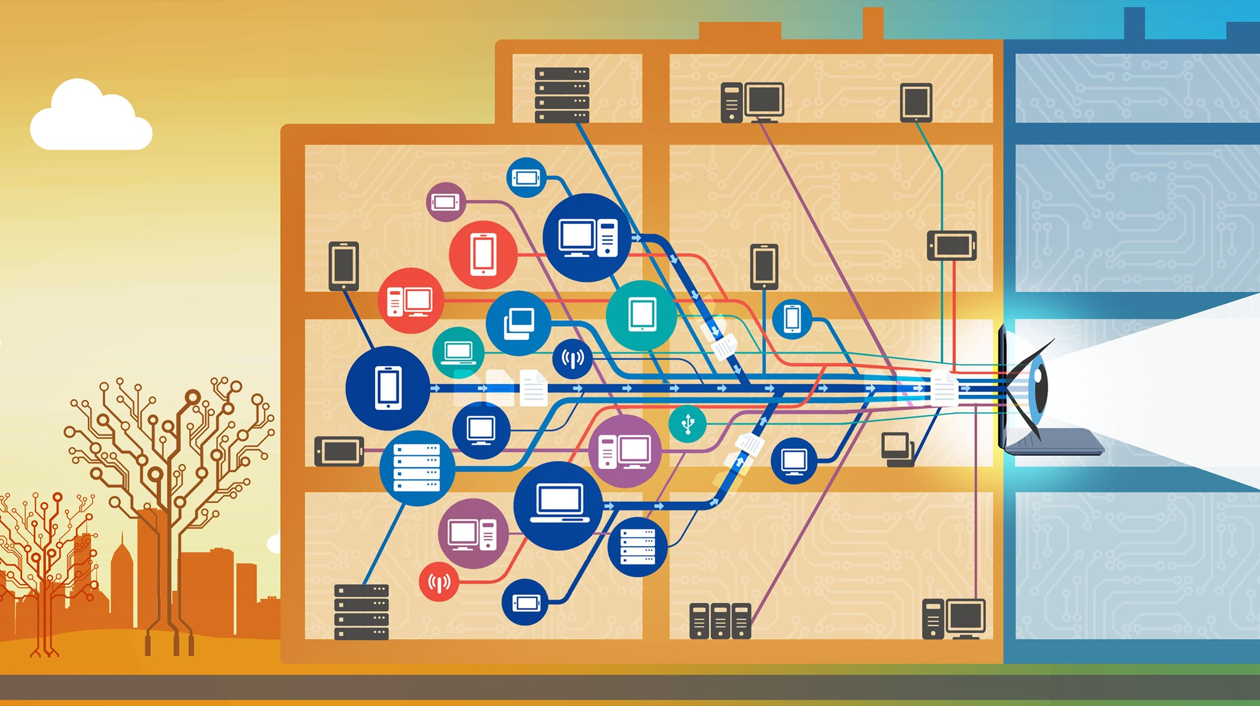
How?

Slide 7


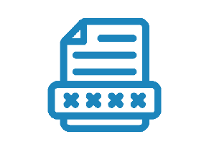

The Cyber Security Assessment Tool is a software product developed by experienced security experts. It collects relevant data from:
Endpoints
Office 365
SharePoint and Intune
Active Directory and Azure AD
Notes:
CSAT helps to create an action plan, based on facts pulled from the IT environment. The CSAT pulls information from:
Endpoints; Windows server and Windows PC’s and Laptops (going back to Windows XP)
Office 365, SharePoint Online or on-prem and Intune
The local Active Directory and the Azure Active Directory

Slide 8




Data Collection
By using agents which delete themselves following the endpoint scan, the effort required from the internal IT department is kept to a minimum.
Endpoints
Azure AD
SharePoint on-prem
Questionnaire
Automated report with recommendations based on facts
Active Directory
Notes:
The CSAT uses dissolvable agents to collect data from the endpoints. These are small executables that delete themselves after the data has been retrieved and transmitted to the CSAT server
We use an administrator accounts to access and scan Active Directory and SharePoint on-prem
The Microsoft cloud services are accessed via the available Microsoft API’s
The CSAT software can be installed in the customers Azure environment on a VM, or on-premises on a Windows machine.
There is also a Questionnaire which we use to assess the elements of your customer’s security maturity which are not system based.
Once the scan and the questionnaire have been completed, the CSAT produces an automated report in a Word document which can be edited to provide extra information.

Slide 9
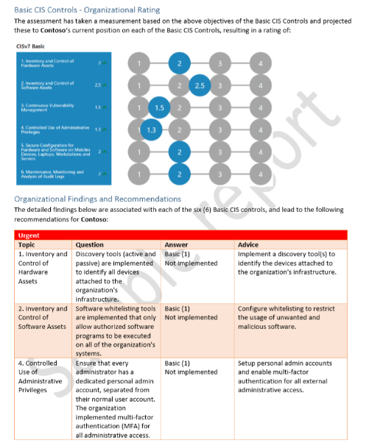
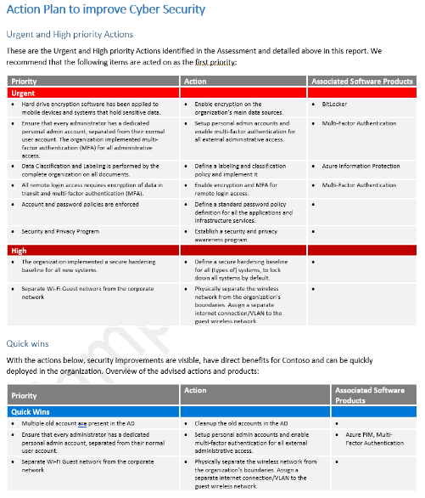
Cybersecurity maturity and action plan
Notes:
The results will be presented in final reports. This is a screenshot from a sample Executive summary report. An important document to start the conversation about security with the Management Team. It’s not just an IT discussion, it is supposed to be a management decision too! With the fact-based recommendations, and the prioritized action list, it is easy to get the conversation started and to allocate budgets to the right security projects.

Slide 10

Cyber Security Assessment Tool
Quick Results – Automated scan, questionnaire, reporting
Provides recommendations based on facts
Risk-based Action Plan
Notes:
To summarize: the CSAT promises quick results with an automated scan and the Word reports. It will provide recommendations based on facts from the customer’s IT environment, creating a risk-based action plan to improve the customer’s cyber security.

Slide 11
Demo

Slide 12
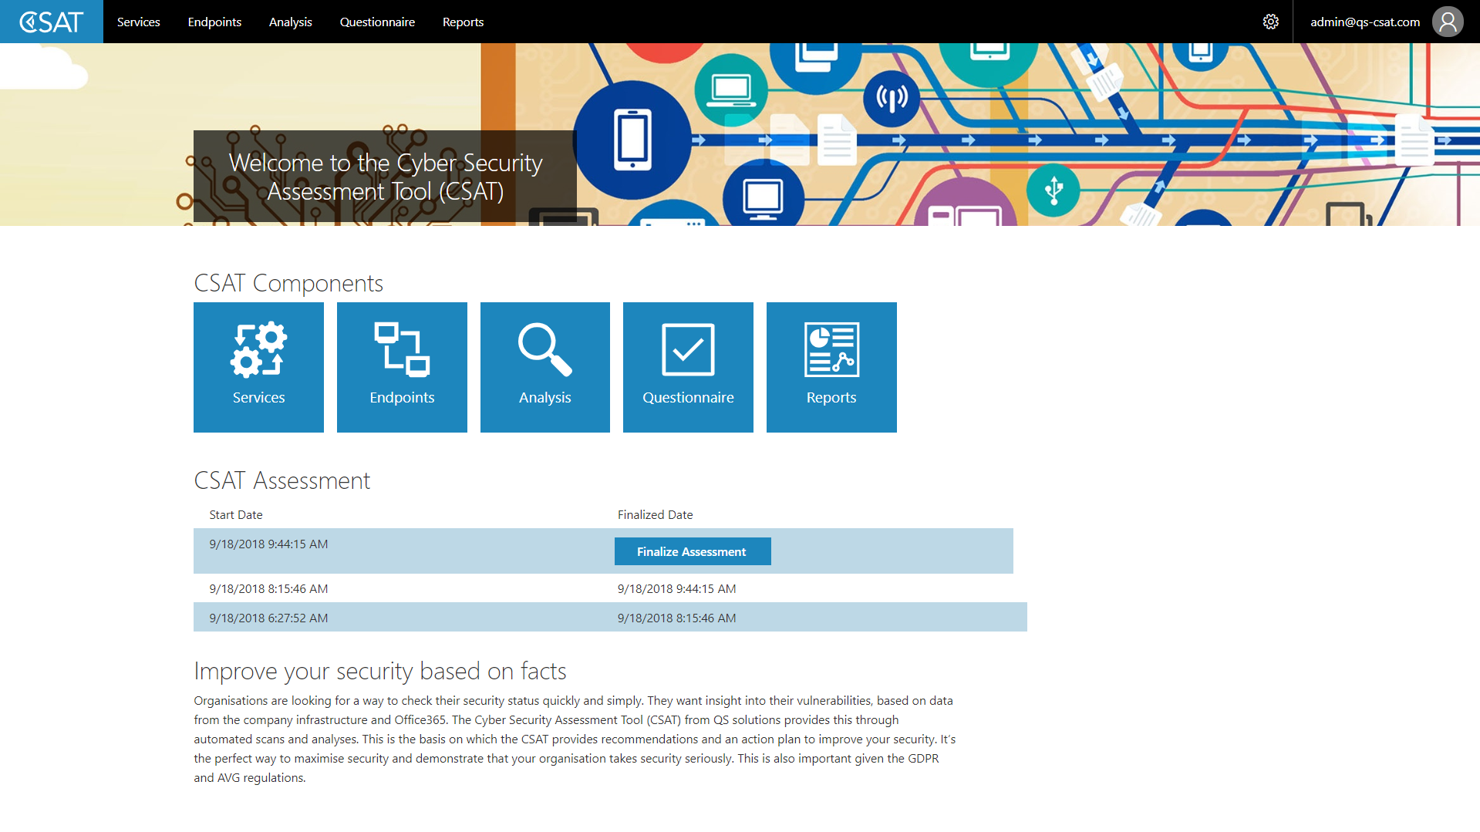
Notes:
CSAT homescreen

Slide 13
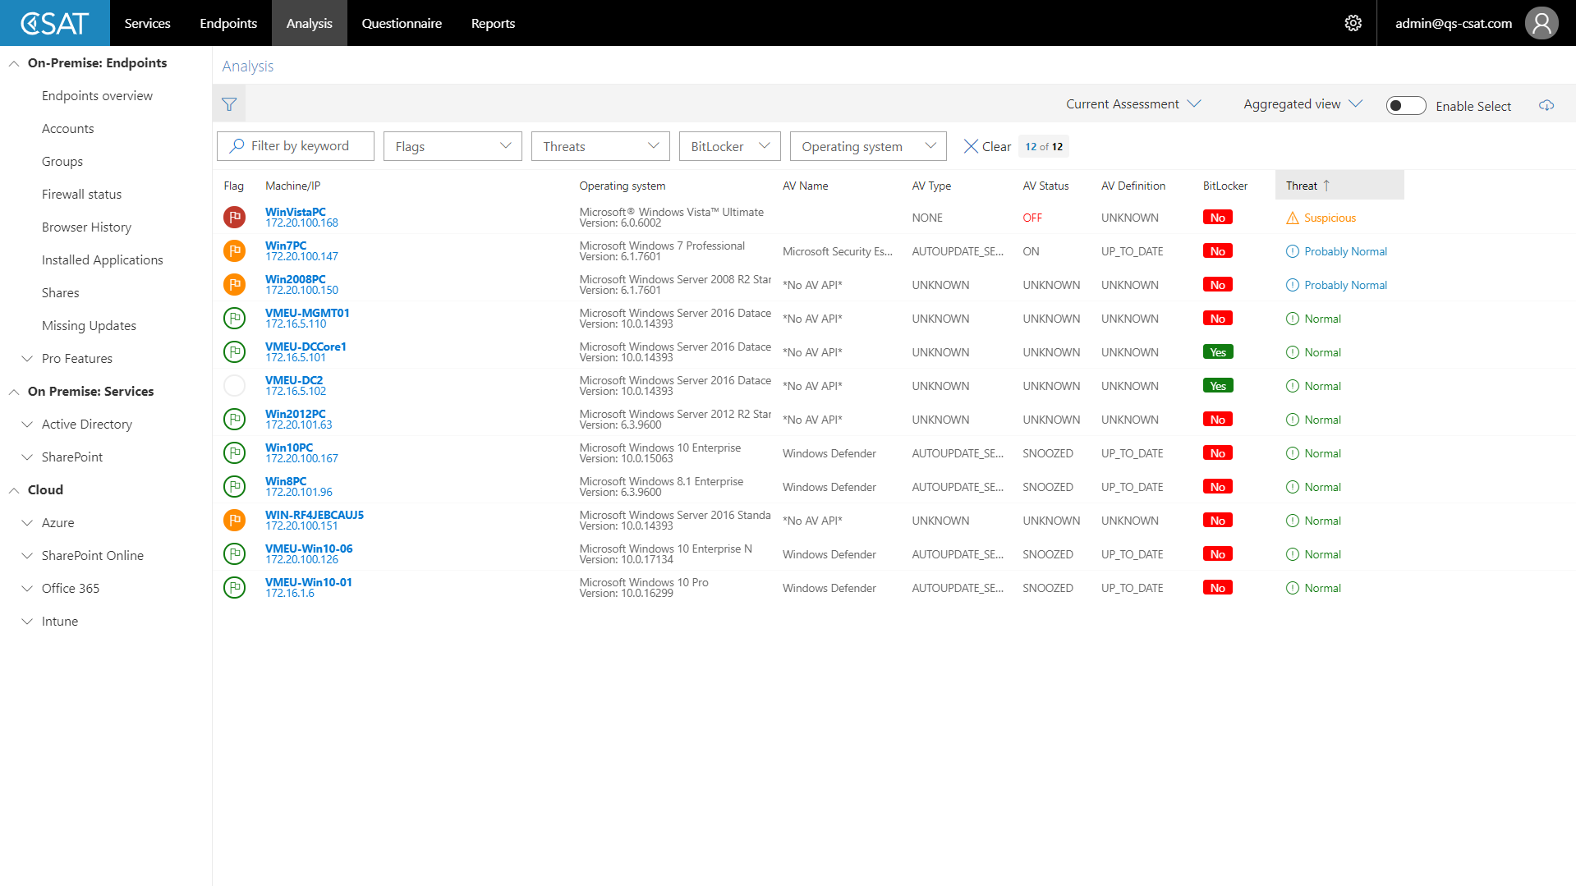
Notes:
Endpoint Analysis

Slide 14
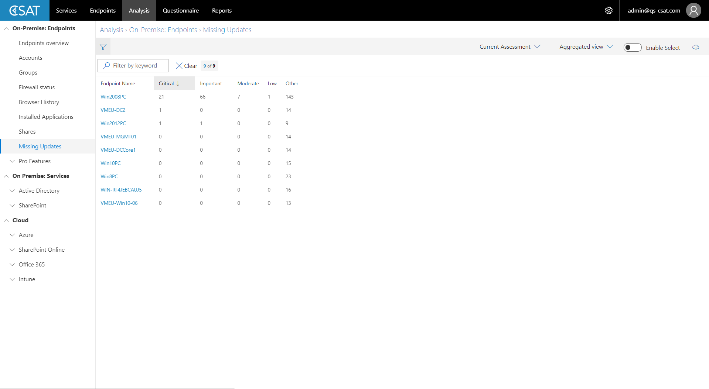

Slide 15
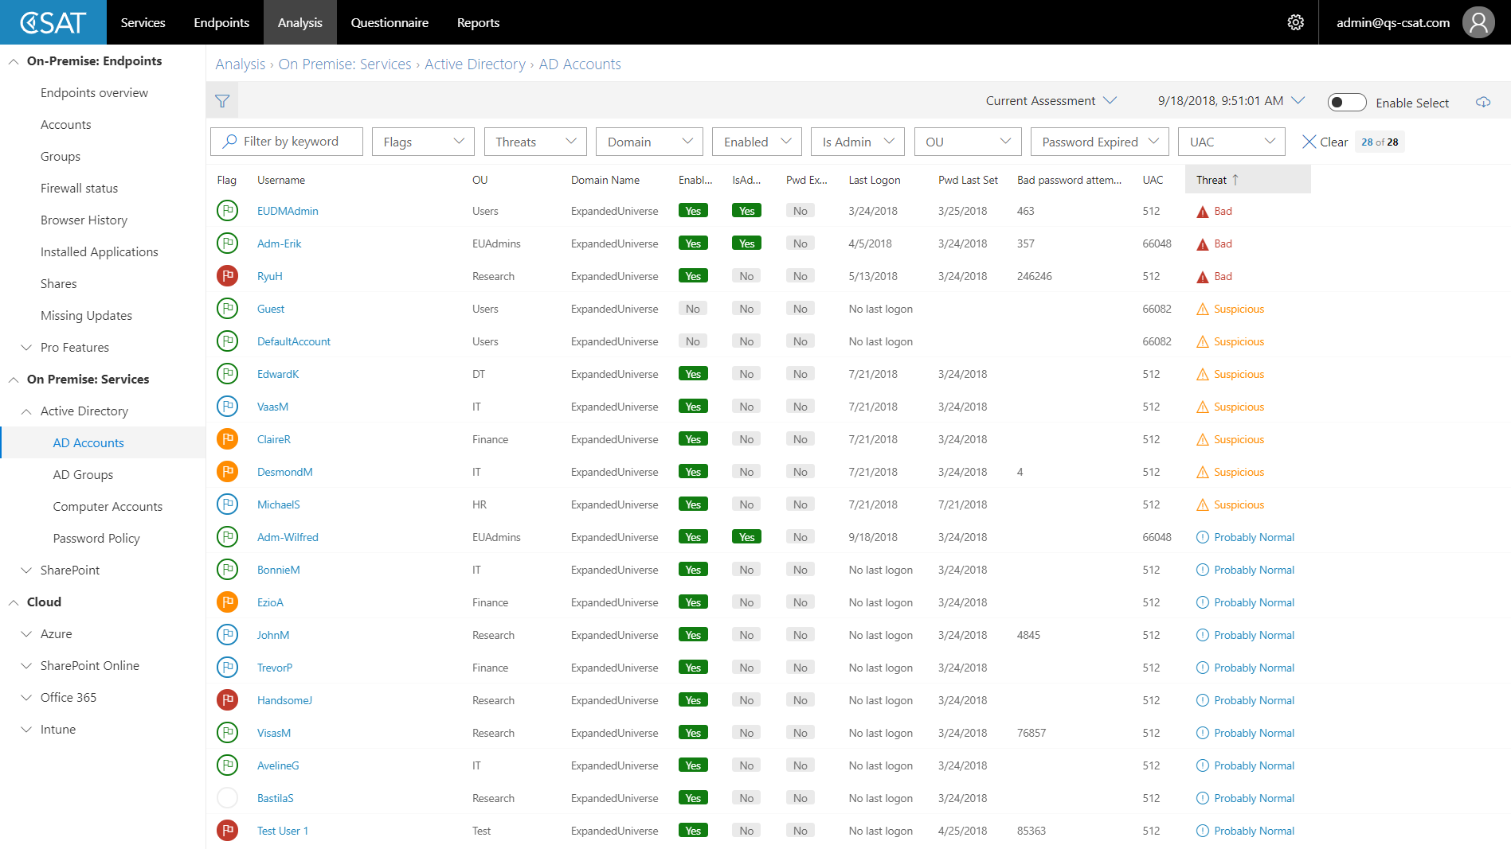

Slide 16
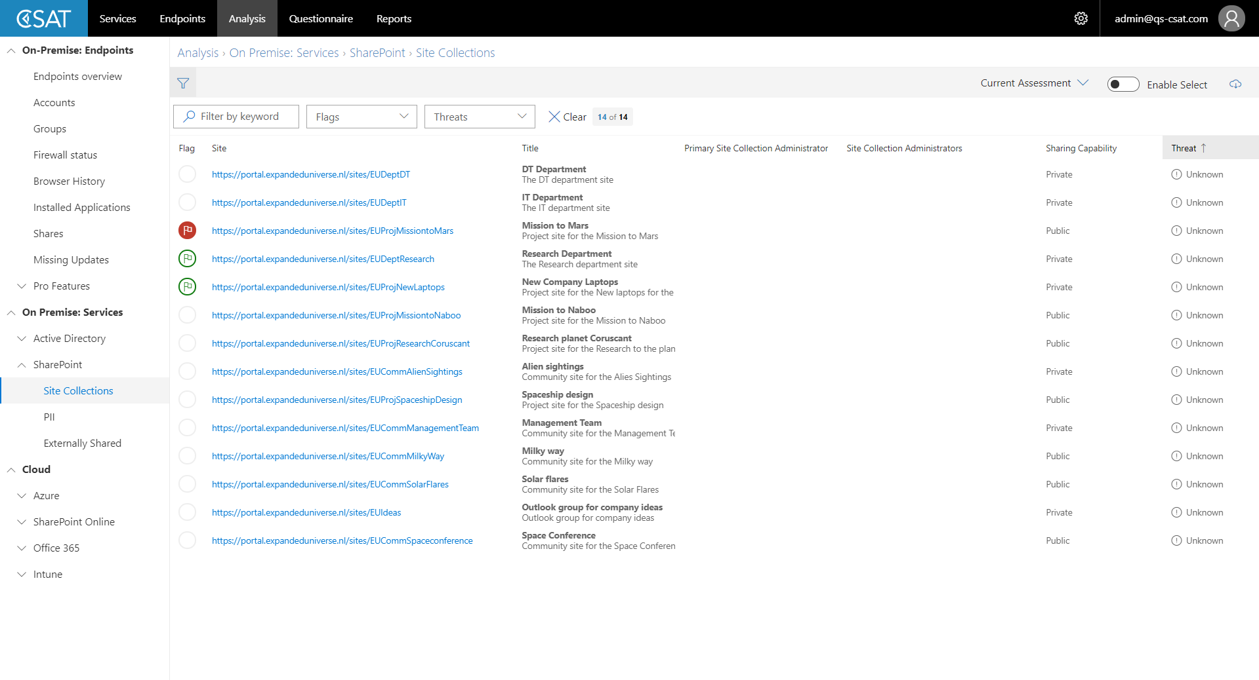

Slide 17
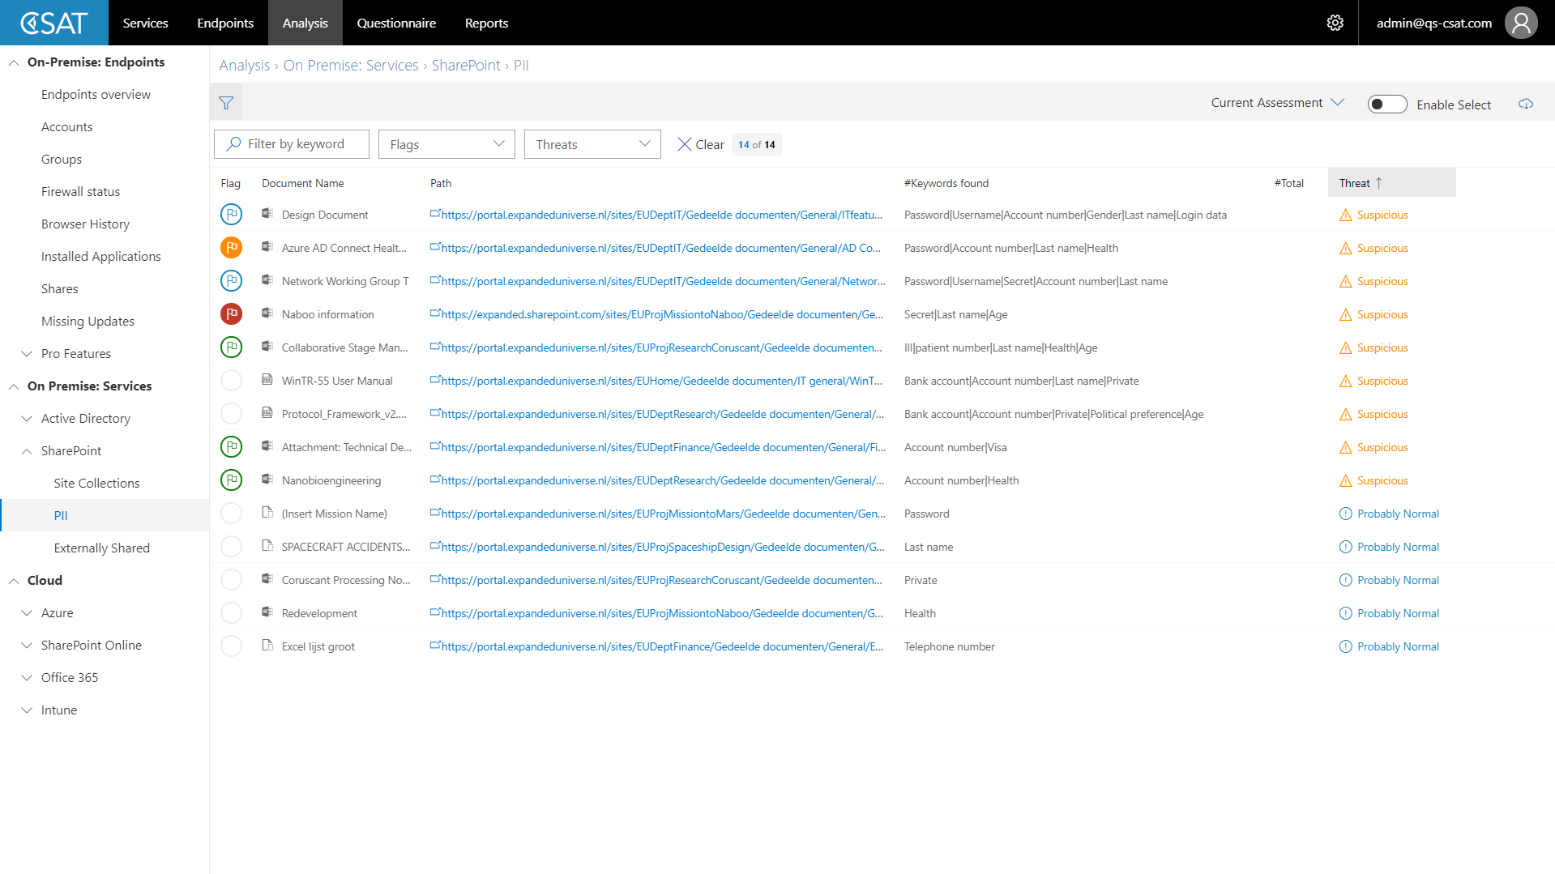

Slide 18
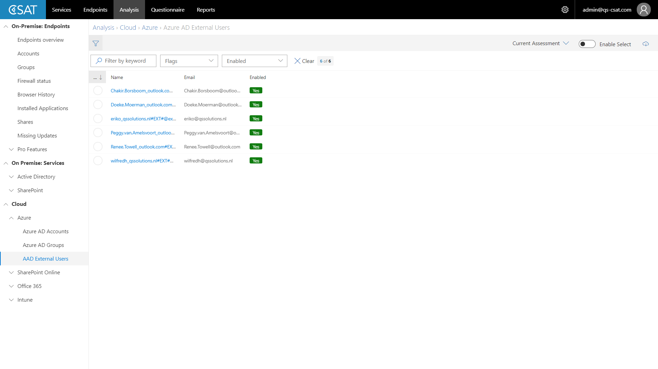

Slide 19
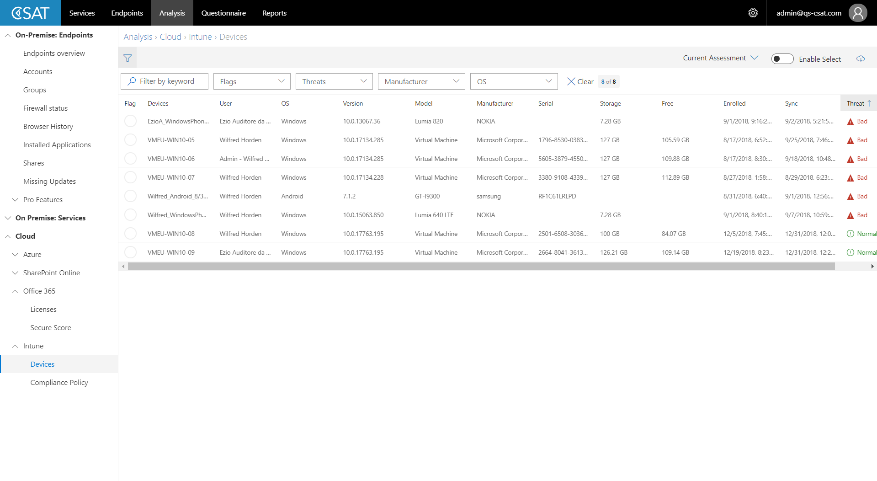

Slide 20
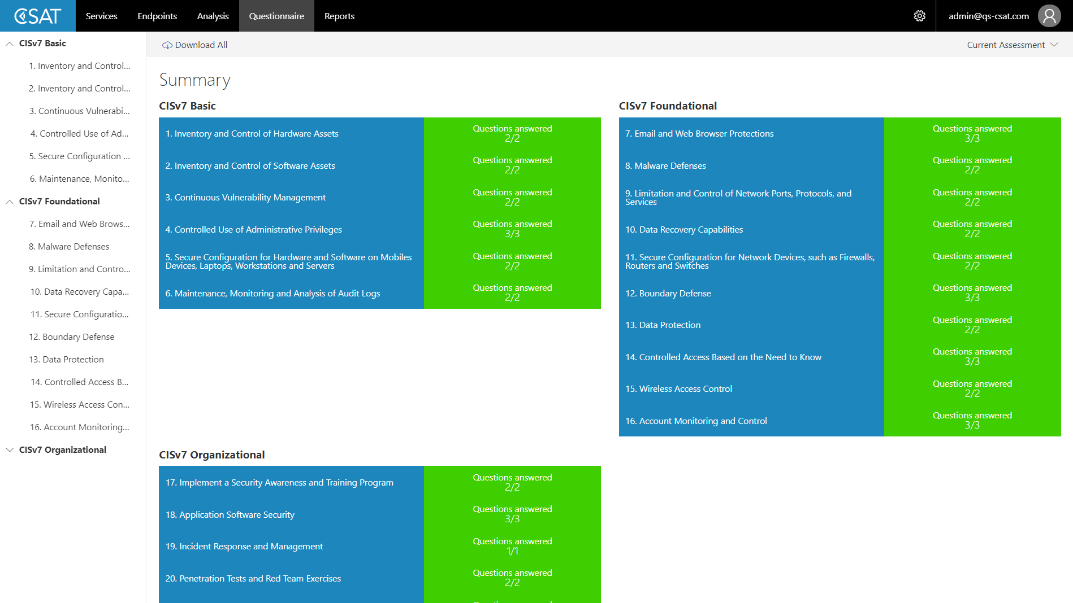

Slide 21
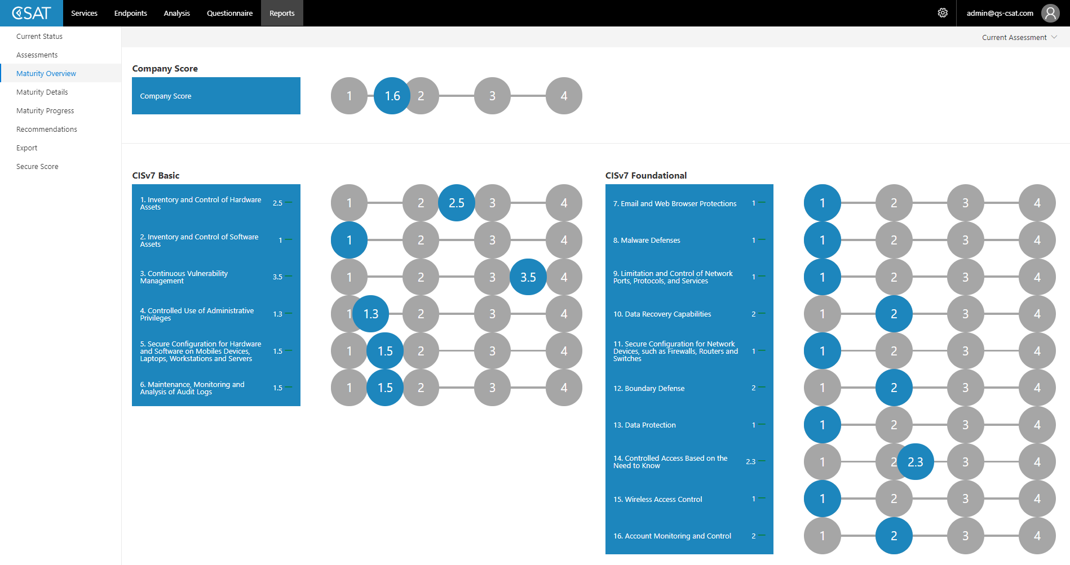

Slide 22
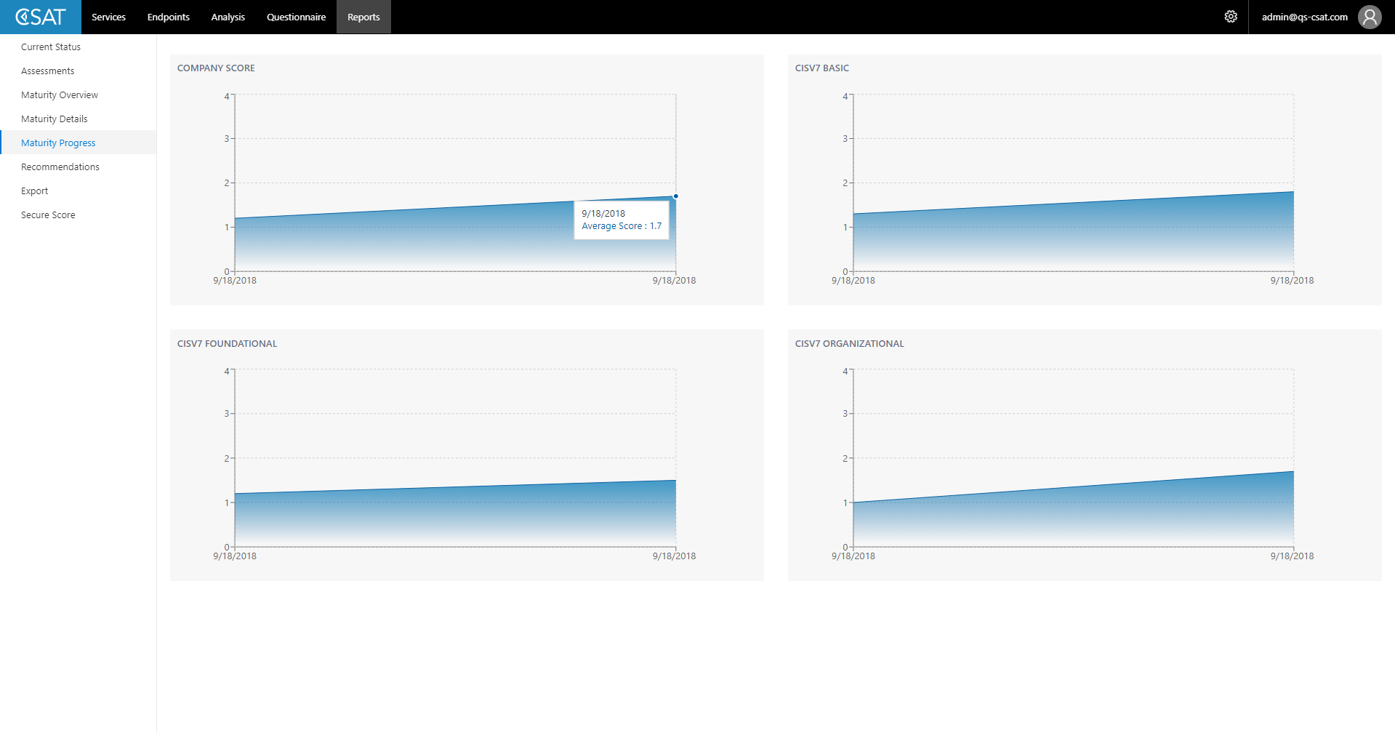

Slide 23
Get started?

Slide 24
Typical Engagement Timeline
Day 1
Day 2
Day 3
Deliverable
Intake and installation
Review of Data and Questionnaire
Report
Maturity Assessment
Recommendations
Action plan
Data Collection
Report Creation & Presentation
Notes:
This is a typical engagement timeline. As a customer, you would spend around 1,5 days of your time in the engagement together with a partner. The Partner will do the analysis and reporting.

Slide 25
The value of CSAT
Align
IT/Security shares fact-based conclusions and recommendations with Business Management
Offers risk-based action plan for security improvements
Optimize
Saves money if available Microsoft licenses are deployed
Prevents deployment of point solutions
Control
Proves that you take security seriously
Shows that you work towards compliance

Slide 26

Cyber Security Assessment Tool

